Slide 1
Diabetic Neuropathy: Pathophysiology
Rayaz A. Malik, MB ChB, PhD
Professor of Medicine, Weill Cornell Medicine, Doha, Qatar
University of Manchester, Manchester, England, UK
NON-2023-7969

Slide 2
Disclaimer
Viatris makes no claim or warranty of, and is not responsible for, any medical, scientific, or other information that may be disseminated through this program/presentation. Viatris does not make, and expressly disclaims, any representations or warranties of any kind, either express or implied (including, without limitation, any implied warranties of content or non-infringement) with regard to any such information, its accuracy, or completeness. This scientific meeting is for the sole purpose of education and discussion only. Statements of fact and opinions expressed are those of the Speaker and are not the opinion or position of Viatris. Viatris does not recommend the use of its products in any manner inconsistent with that described in the full prescribing information. Nothing contained in this program/presentation should be construed as medical advice or should replace treatment or recommendations from qualified healthcare providers which may vary from patient to patient. The viewers assume all risk for use of the information and the content provided in this program/presentation. In no event shall Viatris or any of its affiliates, directors, employees, officers. consultants, and service providers be liable for, directly or indirectly, any damages of any kind or nature, including without limitation, direct, indirect, incidental, consequential, or any claims or losses. whether foreseeable or not or whether the user has been informed of the possibility in advance, resulting from or in connection with the creation or use of or reliance in the program/presentation.​
​.

Slide 3
Disclosures - Rayaz Malik
Funding for an investigator-initiated study on long-COVID from Proctor & Gamble.
Funding from Novo Nordisk for the PACT-MEA study.
Speaker’s Bureau/Speaker: Eli Lilly, Novo Nordisk, Sanofi, Viatris
Advisor: Eli Lilly, Novo Nordisk, Sanofi, Viatris

Slide 4
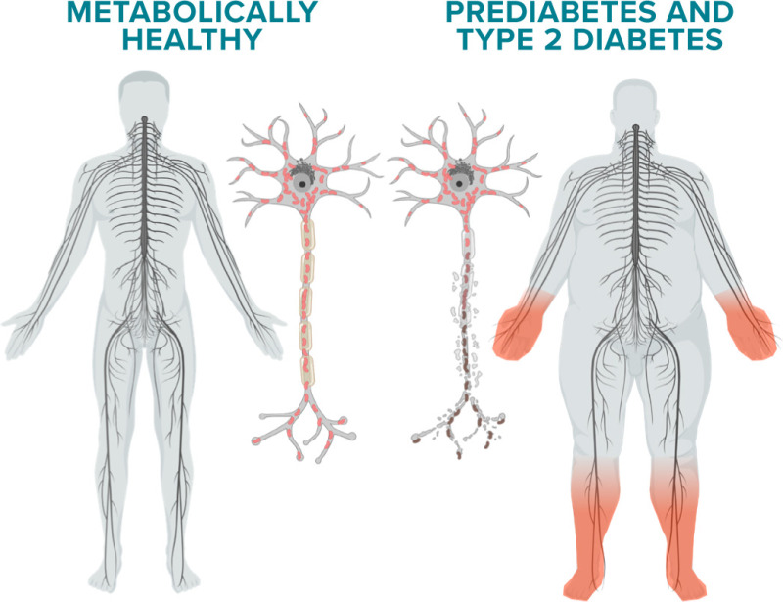
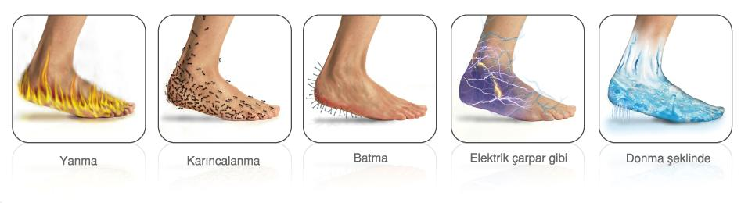
Diabetic Neuropathy Prevalence¹
50%-90% of diabetic patients have DPN¹
Up to 20% of patients with DM develop pDPN²
DM, diabetes mellitus; DPN, diabetic peripheral neuropathy; pDPN, painful diabetic peripheral neuropathy.

Slide 5
Higher Prevalence of DPN and pDPN in the Arabian Gulf Region
33.3% DPN
Prevalence of DPN, those at risk of DFU, and pDPN in patients with T2D in secondary healthcare
53.6% undiagnosed
52.2% at risk of DFU
≤0.0001
n=3021
≤0.0001
≤0.0001
43.3% pDPN
54.3% undiagnosed
2.9% DFU
DFU, diabetic foot ulceration; DPN, diabetic peripheral neuropathy; KSA, Kingdom of Saudi Arabia; pDPN, painful diabetic peripheral neuropathy; T2D, type 2 diabetes.

Slide 6
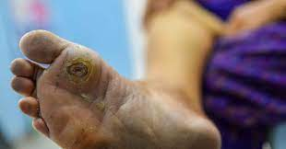
Risk of Foot Ulceration in DM¹
Lifetime risk of developing diabetic foot ulcer (DFU): up to 34%²
20% of DFU result in amputation²
DM, diabetes mellitus.

Slide 7
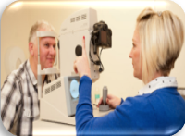
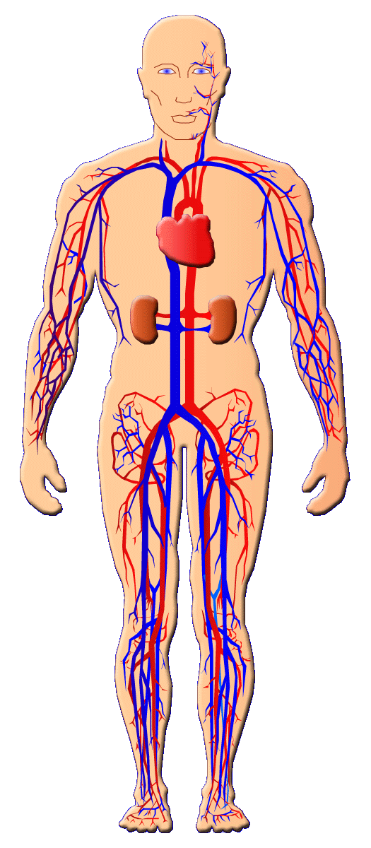
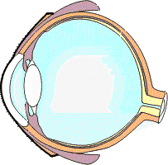
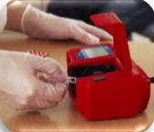
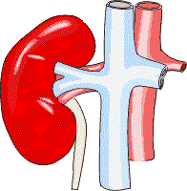

DM Microvascular Complications¹
Diabetic Retinopathy
Diabetic eye screening
2,587,000 patients
(81%)
Diabetic Nephropathy
Microalbuminuria & eGFR
~95%
Cinderella complication²
Diabetic Neuropathy
Late diagnosis³
Patients suffer³
No FDA-approved disease-modifying treatment⁴
DM, diabetes mellitus; FDA, Food and Drug Administration.
  3. Yang H, et al. Front Endocrinol (Lausanne). 2020;10:929.
  4. Malik RA. Diabetes Metab Res Rev. 2020;36(suppl 1):e3255.

Slide 8
Fibers Affected in DPN¹
Initial small-fiber involvement Large-fiber involvement
Subsequent mixed small/large fiber involvement
Sensory nerve fiber subpopulations²
Unmyelinated C fibers
Polymodal Nociceptive, Temperature,
Slow Pain, Postganglionic Sympathetic
Myelinated
A_{δ} fibers
A_{β} fibers
Mechanoreceptive, Pressure, Temperature, Fast Pain
Cutaneous Touch,
Pressure
DPN, diabetic peripheral neuropathy.

Slide 9
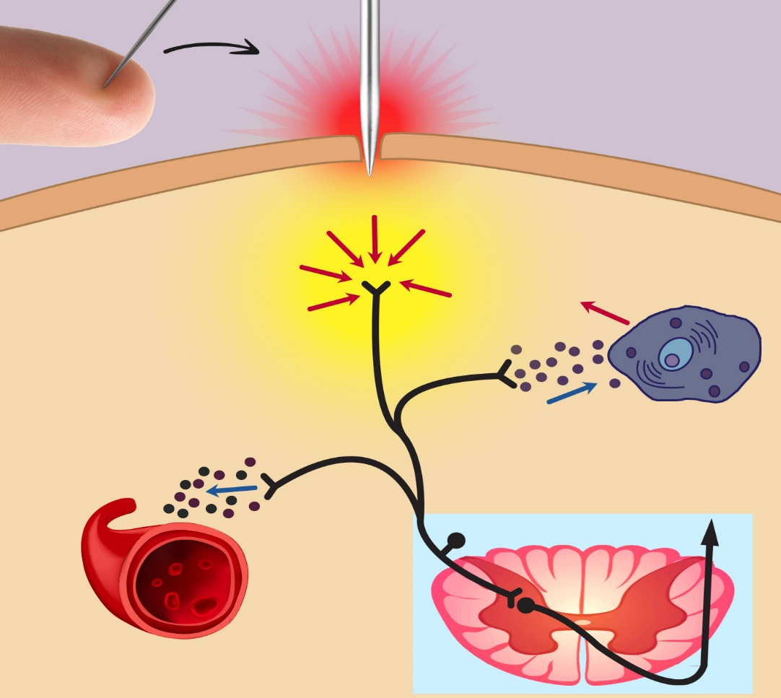
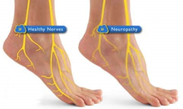

Small Fibers Regulate Pain and Blood Flow^{1,2}
Stimulation of C fibers¹
Inflammatory/vasodilator response to tissue damage²
Small fiber damage³
Tissue injury
Bradykinin
ATP
Prostaglandin
5-HT
Mast cell
or neutrophil
H⁺
Histamine
CGRP
Substance P
Substance P
Blood vessel
Anterolateral
system
Dorsal root
ganglion
cell body
ATP, adenosine triphosphate; 5-HT, 5-hydroxytryptamine; DPN, diabetic peripheral neuropathy; H, hydrogen.
1. Sharma, et al. Diabetes Metab Res Rev. 2020;36:e3244.
2. Purves D, et al. Neuroscience. 2nd edition. Sunderland (MA): Sinauer Associates; 2001. Accessed October 23, 2023, https:wwwncbi.nih.gov/books/NBK10799/
3. Sharma S, et al. J Diabetes Sci Technol. 2022;16(2):321-331.

Slide 10
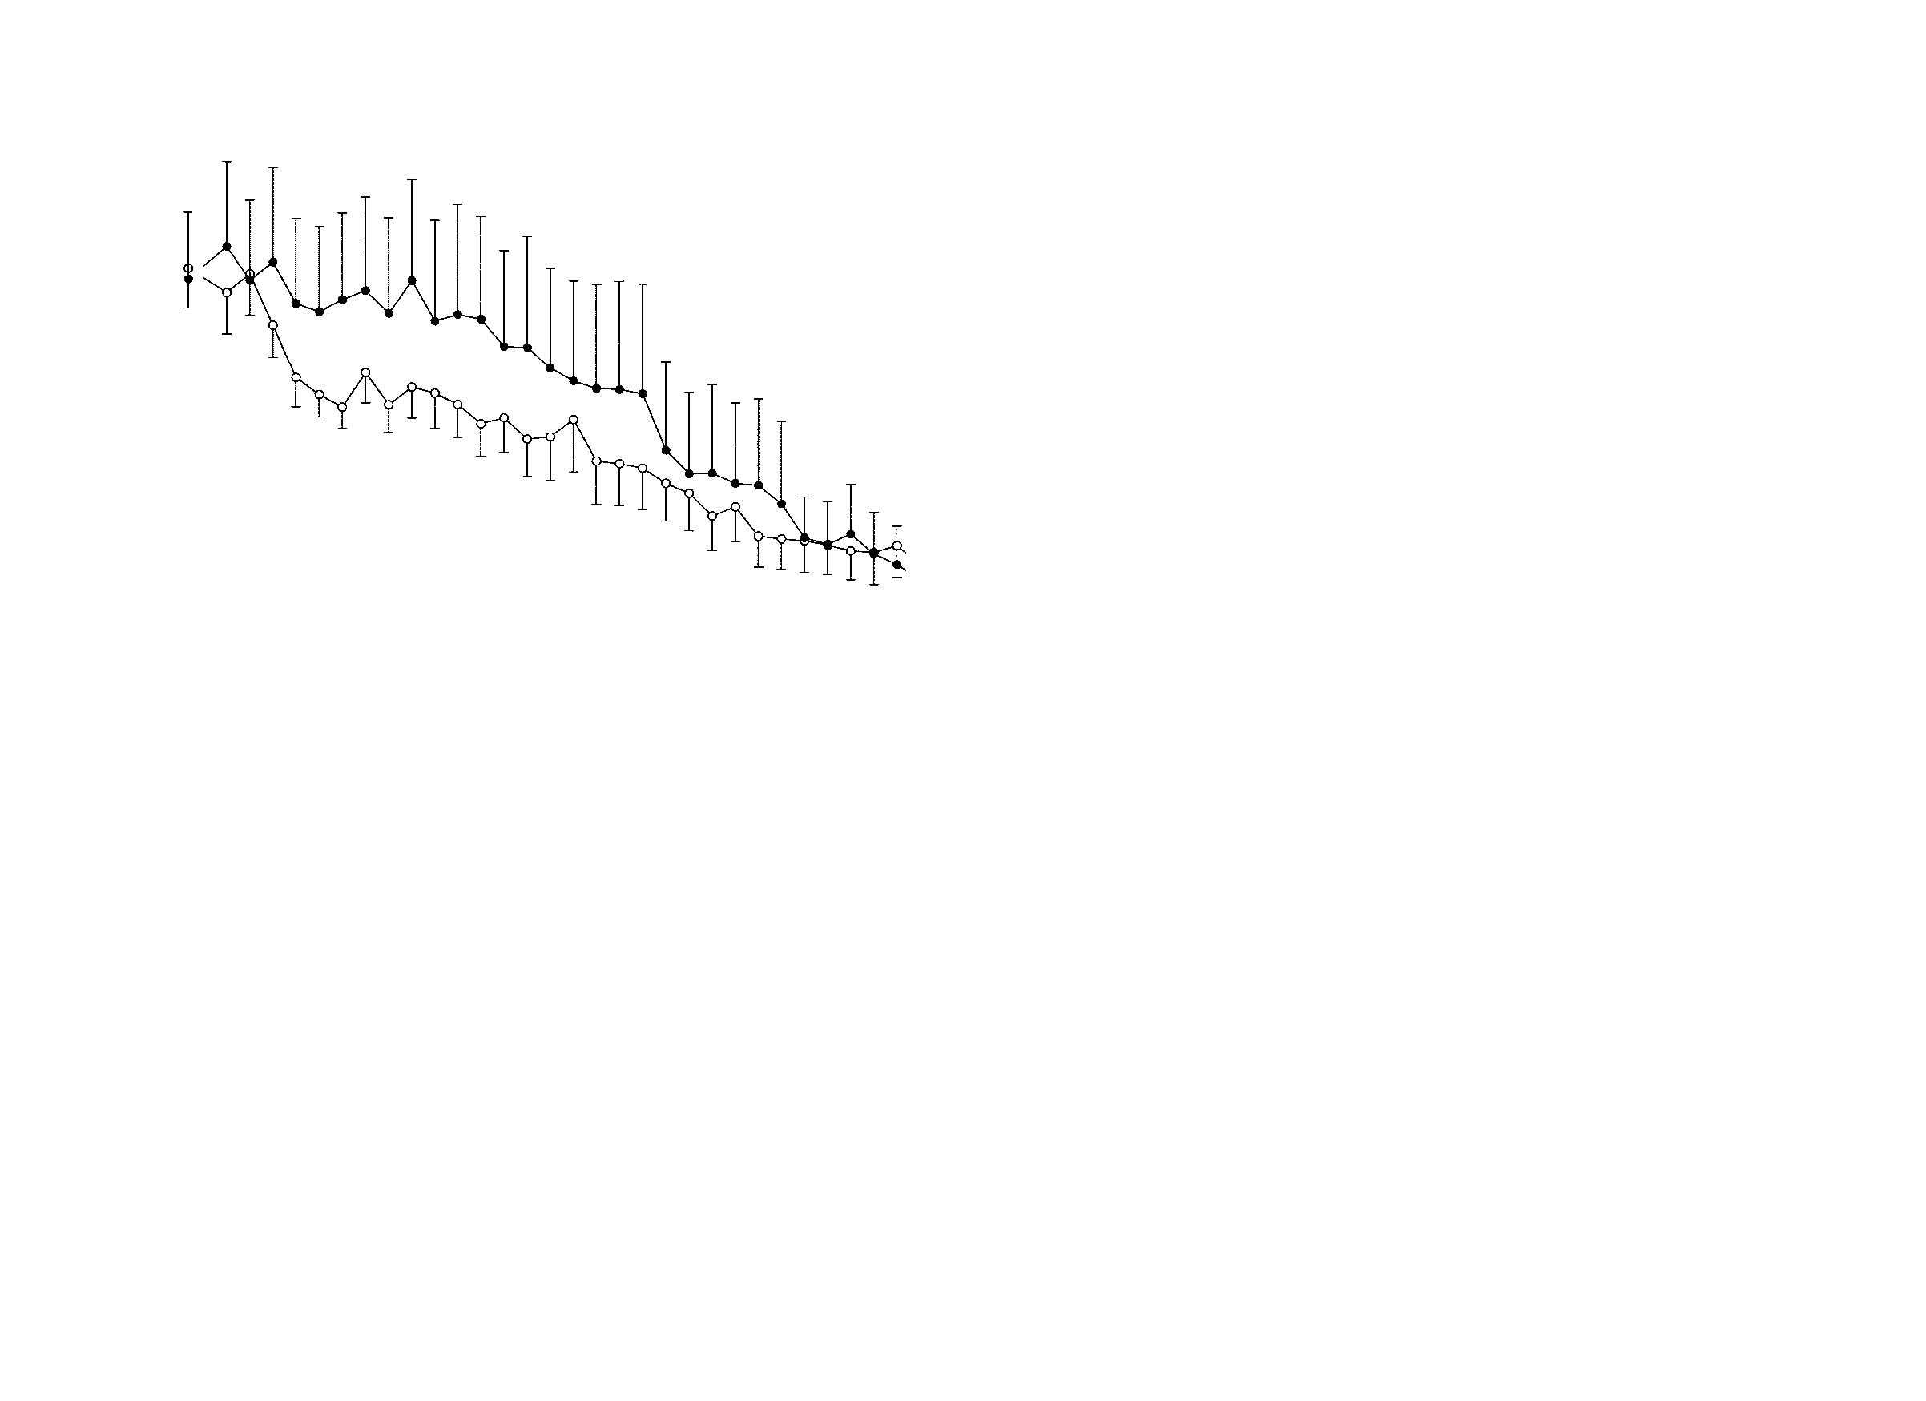
Small-fiber Damage Impairs Pressure-induced Vasodilation, which Results in DFU¹⁻³
Skin blood flow was measured with Doppler in DPN²
Pressure required to reduce tissue blood flow to a critical level²
Control (n=15)
Control subjects | 48.8 mmHg
Diabetic without neuropathy | 7.5 mmHg
Diabetic Neuropathy | 6.3 mmHg
Diabetic
without neuropathy
(n=15)
au, arbitrary units; DFU, diabetic foot ulceration; DPN, diabetic peripheral neuropathy; SE, standard error.

Slide 11
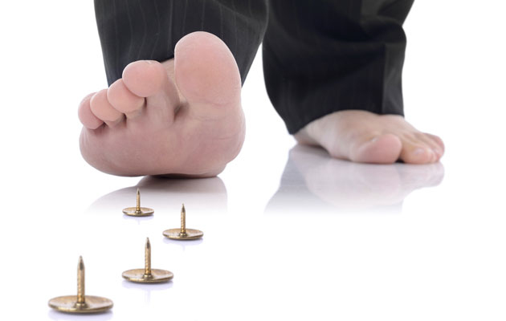
Impaired Hyperaemic Response in DPN^{1,2}
Skin blood flow was significantly lower in the diabetic group than the control group¹
P<0.001
n=21
n=23
DPN, diabetic peripheral neuropathy; V,values.

Slide 12
Small-fiber Damage Impairs Wound Healing¹
Distribution of the cutaneous nervous system in the skin²
Wound healing phases and role of neuromediators²
Inflammatory Phase²
Proliferative Phase²
Remodeling Phase2

Slide 13
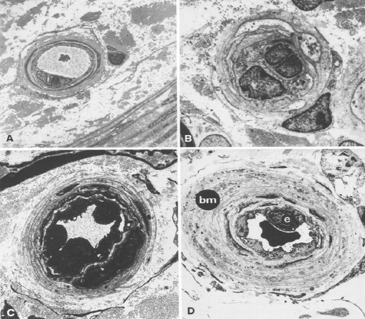
Microangiopathy Underlies DPN¹
Capillary abnormalities increase with the severity of neuropathy²
Electron micrographs of endoneurial capillaries in sural nerve biopsies
control subject
diabetic non-neuropathic patient
diabetic mildly neuropathic patient
diabetic severely neuropathic patient
DPN, diabetic peripheral neuropathy.

Slide 14
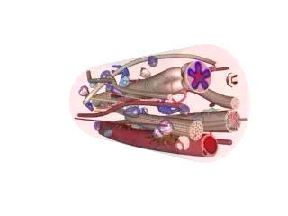
Microangiopathy in DPN
DPN, diabetic peripheral neuropathy.
Malik RA, et al. Diabetologia. 1989;32:92-102.

Slide 15
Mechanism of Diabetic Neuropathy
Type 1
Hyperglycemia
Dyslipidemia
↑Triglycerides
↑LDL
↓HDL
↑FFA
Type 2
Glucose
IGT/MetS
Protein
Oxidation
Lipid
Oxidation
Insulin
↓Insulin +
C-peptide
Glucose
Inflammatory
Signals
FFAs
Insulin
signaling
Glycolysis
PI3-K
Electron transport overload
Cholesterol
Akt
Insulin
resistance
ROS
RNS
Oxysterols
DNA
Damage
ER
Stress
Mitochondrial
Dysfunction
Cellular Injury and Irreversible Damage
Akt, serine/threonine kinase; DNA, deoxyribonucleic acid; ER, endoplasmic reticulum; FFA, free fatty acids; HDL, high-density lipoprotein; IGT, impaired glucose tolerance; LDL, low-density lipoprotein; MetS, metabolic síndrome; ROS, reactive oxygen species; RNS, reactive nitrogen species.

Slide 16
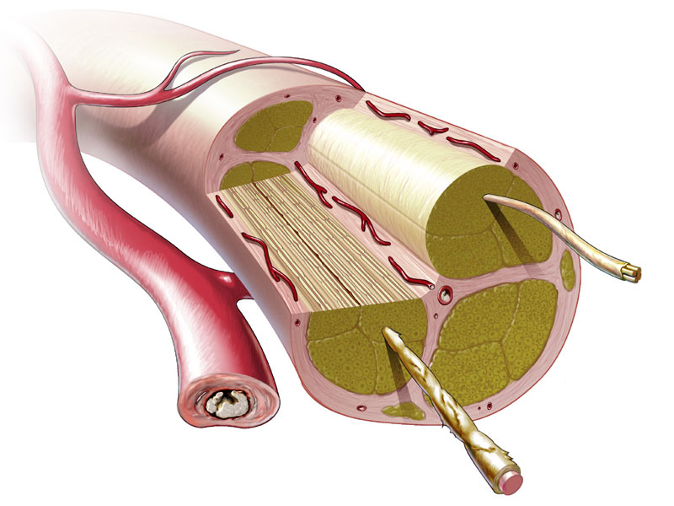
Risk Factors for DPN (T1D)
n= 1172
1.57
Hypertension
P=0.03
1.38
Smoking
P=0.03
1.48
HbA1c
P<0.001
1.36
Change in HbA1c
P=0.001
1.40
Diabetes duration
P=<0.001
1.27
BMI
P=<0.001
1.21
Triglycerides
P=0.03
1.15
Total cholesterol
P=0.08
1
2
3
BMI, body mass index; DPN, diabetic peripheral neuropathy; HbA1c, glycosylated hemoglobin; T1D, type 1 diabetes.
0.9
4

Slide 17
Risk Factors for DPN/pDPN (T2D)
n=3021
 | P≤0.0001 |  | P<0.01
 | P≤0.0001 |  | P=0.16
 | P≤0.0001 |  | P=0.08
 | P≤0.0001 |  | P≤0.0001
 | P≤0.0001 |  | P≤0.0001
 | P≤0.0001 |  | P<0.01
 | P=0.01 |  | P=0.001
 | P=0.12 |  | P=0.19
 | P≤0.0001 |  | P≤0.0001
 | P≤0.0001 |  | P≤0.0001
 | P<0.01 |  | P=0.06
DPN, diabetic peripheral neuropathy; pDPN, painful diabetic peripheral neuropathy; T2D, type 2 diabetes.

Slide 18
Effect of Tight Glycemic Control in DPN¹
Type 1²
n=1228
Type 2²
n=6669
Enhanced versus standard therapy²
Incidence of clinical neuropathy after 5 years
Incidence of clinical neuropathy over different time periods
Study or subgroup | Enhanced n/N | Control n/N | Risk Ratio M-H, Fixed, 95% CI | Weight | Risk Ratio M-H, Fixed [95% CI]
DCCT 1993a | 17/252 | 42/292 |  | 36.5% | 0.47 [0.27, 0.80]
DCCT 1993b | 30/327 | 60/315 |  | 57.3% | 0.48 [0.32, 0.73]
Linn 1996 | 1/23 | 6/19 |  | 6.2% | 0.14 [0.02, 1.05]
Total (95% CI) | 602 | 626 |  | 100.0% | 0.46 [0.33, 0.63]
Total events: 48 (Enhanced), 108 (Control) Heterogeneity. Chi^{z} = 1.42, df=2 (P= 0.49); 1^{z} =0.0% Test for overall effect: Z = 4.80 (P < 0.00001) Test for subgroup differences: Not applicable
Study or subgroup | Enhanced n/N | Standard n/N | Risk Ratio M-H, Fixed [95% CI] | Risk Ratio M-H, Fixed [95% CI]
ACCORD 2010 | 1277/2815 | 1338/2791 |  | 0.95 [0.89, 1.00]
Azad 1999 | 11/35 | 12/35 |  | 0.92 [0.47, 1.79]
Duckworth 2009 | 178/464 | 199/498 |  | 0.96 [0.82, 1.12]
Tovi 1998 | 0/16 | 0/15 |  | 0.0 [0.0, 0.00]
P<0.00001
NS
Favors enhanced
Favors standard
Favors enhanced
Favors standard
ACCORD, Action to Control Cardiovascular Risk in Diabetes; CI, confidence interval; DDCT, Diabetes Control and Complications Trial; DPN, diabetic peripheral neuropathy.

Slide 19
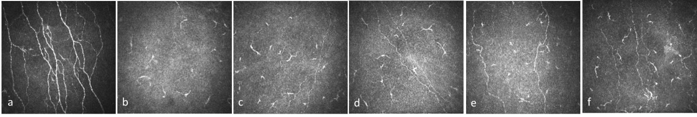
Pancreas and Kidney Transplantation (SPK) Leads to Early Small-Nerve Fiber Regeneration, with Later Improvement in Neuropathic Symptoms and NCV
Corneal confocal images of the sub-basal nerve plexus
Control SPK baseline 6 months 12 months 24 months 36 months
n=36 type 1D and end-stage renal failure undergoing SPK
Change from baseline values
CNFL
NSP score
Peroneal NCV
Sural nerve amplitude
**
**
*
*
**
*
CNFL, corneal nerve fiber length; NCV, nerve conduction velocity; NSP, Neuropathy Symptom Profile; SPK, simultaneous pancreas, and kidney transplantation.

Slide 20


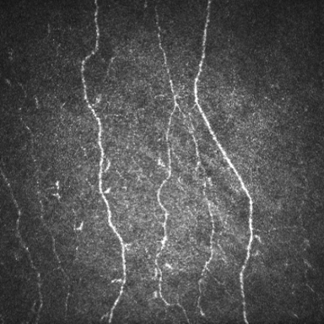
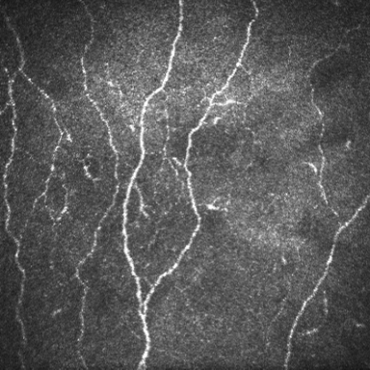
DPN Is Associated with Lower Physical Activity
Physical inactivity
2 years
Physical activity
CNFD
CNFD
Effect of physical activity and inactivity on corneal nerve fiber measures over 2 years
P<0.05
P≤0.0001
P≤0.001
P≤0.01
P≤0.01
n= 26 controls
n= 78 T2D
CI, confidence interval; CNBD, corneal nerve branch density; CNFD, corneal nerve fiber density; CNFL, difference in corneal nerve fiber length; DPN, diabetic peripheral neuropathy; T2D, type 2 diabetes.

Slide 21
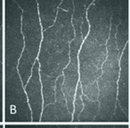
Bariatric Surgery Leads to Nerve Regeneration
Obese subjects with DM
Obese subjects
Corneal confocal microscopy images
n=26
n= 26 obese without diabetes
n= 20 controls
Corneal confocal microscopy
before and after bariatric surgery¹
Corneal nerve morphological parameters
at baseline and 12 months visits²
P<0.0001
P=0.005
P=0.008
P=0.001
P=0.2
P=0.2
DM, diabetes mellitus; CNBD, corneal nerve branch density; CNFD, corneal nerve fiber density; CNFL, difference in corneal nerve fiber length.

Slide 22
Effect of Trandolapril (ACE Inhibitor) in DPN
The ACE inhibitor trandolapril improved nerve conduction at 12 months in normotensive patients with diabetes
P=0.03
ACE, angiotensin-converting-enzyme; DPN, diabetic peripheral neuropathy.

Slide 23
ACE Inhibitor and ACE Inhibitor/Calcium Channel Blocker in DPN
Neuropathy-related outcomes in subjects with type 2 hypertension and diabetes with albuminuria <200 mg/min (N=380)
Outcomes | Manidipine plus Delapril versus Placebo | Delapril versus Placebo
Neuropathy at Three Years* | 0.31 (0.13 – 0.75), P=0.009 | 0.37 (0.16 – 0.87), P=0.022
New Onset of Neuropathy* | 0.35 (0.13 – 0.93), P=0.036 | 0.31 (0.10 – 0.95), P=0.040
Regression of Neuropathy* | 5.88 (0.54 – 64.52), P=0.147 | 5.48 (0.78 – 38.61), P=0.088
Man + Del Better
Delapril Better
Man + Del Better
Delapril Better
Man + Del Better
Delapril Better
*Adjusted for baseline Total Neuropathy Score and baseline and follow-up diastolic blood pressure.
ACE, angiotensin-converting enzyme inhibitor; CCB, calcium channel blocker; DPN, diabetic peripheral neuropathy.

Slide 24
Fenofibrate* Reduces Minor Amputation in T2D
Effects of fenofibrate on first amputation events and all amputations*
 | Fenofibrate (n=4895) | Placebo (n=4900) |  | HR (95% CI) | P value
 | n (%) | n (%)
First amputation†
Minor | 28 (0.6%) | 52 (1.1%) |  | 0.54 (0.34–0.85) | 0.007
Major | 24 (0.5%) | 26 (0.5%) |  | 0.93 (0.53–1.62) | 0.79
Minor, without large-vessel disease | 18 (0.4%) | 34 (0.7%) |  | 0.53 (0.30–0.94) | 0.027
Major or minor, with large-vessel disease | 34 (0.7%) | 42 (0.9%) |  | 0.81 (0.52–1.28) | 0.37
Any amputation | 45 (0.9%) | 70 (1.4%) |  | 0.64 (0.44–0.94) | 0.02
Multiple events analysis^{ǂ}
All amputations | 73 | 117 |  | 0.63 (0.40–0.97) | 0.04
Favors
fenofibrate
Favors
placebo
* Fenofibrate is not licensed for the reduction of amputation events.
† Patients were counted only once within each category but may be included in more than one category if they had more than one type of amputation. If a patient had more than one type of amputation, or more than one of the same type of amputation, only the first event of each type was analyzed.
^{ǂ} For all events, all amputations for each category are counted (Poisson method).
CI, confidence interval; HR, hazard ratio; T2D, type 2 diabetes.

Slide 25
Oral Omega-3 Fatty Acids May Promote Corneal Nerve Regeneration
Change in corneal nerve fiber length
Improved
P<0.001
Deteriorated
CNFL, central corneal nerve fiber length; PUFA, polyunsaturated fatty acid; T1D, type 1 diabetes.

Slide 26
Key Messages
50% of patients with DPN and pDPN remain undiagnosed¹
Vascular risk factors and microangiopathy underlie diabetic neuropathy; treating these risk factors improves DPN¹⁻⁴
Small fibers are central to the pathophysiology of pain, diabetic foot ulceration and wound healing^{5,6}
DPN, diabetic peripheral neuropathy; pDPN, painful diabetic peripheral neuropathy.
1. Ponirakis G, et al. J Diab Invest. 2022;13:1551-1559.
2. Tesfaye S, et al. N Engl J Med. 2005;352:341-350.
3. Fang F, et al. Eur Rev Med Pharmacol Sci. 2018;22(19):6456-6462.
4. Malik RA, et al. Diabetologia.1989; 32: 92-102.
5. Sharma S, et al. Diabetes Metab Res Rev. 2020;36:e3244.
6. Sharma S, et al. J Diabetes Sci Technol. 2022;16(2):321-331.

